Slide 1
BSBCTR611 Applying critical thinking

Slide 2

Business Overview

Slide 3

The company is Worlducation. This is a social startup founded in 2016 that aims to transform how children learn in school.
The company combines hardware, software, content, and activities, supported by AI technology, to create an optimal learning path for elementary school students.

Slide 4
Mision & Vision
To achieve their vision also operates with a strong social mission: donating and training classrooms around the world that cannot afford technology, with the vision of a world without illiteracy.
Their mission is to be the change and facilitate a world without illiteracy by changing the way children learn in school and the number of schools that have access to technology.

Slide 5

Their core values are:
Ethical principles
Innovation
Collaboration.
Strategic Priorities
To be well led, high performing, profitable and accountable.
Increase their reach
Continue building deeper customer relationships
Attract, engage and develop the best staff

Slide 6
What the company does

Slide 7

Worlducation manufactures tablets for elementary school students and develops educational software and content that adapts to each child's learning progress.
Currently, the company sells tablets and software subscriptions to schools, where teachers coordinate classroom activities. This business model is B2B.

Slide 8
Stakeholders

Slide 9

About my role
IT professional under the supervision of Divya Sapra.
Analyzing systems and resolving complex business problems, especially those related to:
ERP system
supply chain
software delivery
technology solutions.

Slide 10

Senior Management and Founders
Operations Team
Manufacturing Team
Sales Team
Customers
Finance Team and Investors
IT Professional (My Role)
IT Professional Supervisor (Divya Sapra)

Slide 11
Summary of Numeric and Financial Data

Slide 12
Summary
Although demand increased Revenue by 57% compared to the previous year, the Net Profit Margin fell to less than half (from 20% to 9.1%).
Performance | Revenue (millions) | Net Profit (millions) | Net cash flow (millions)
2019 (current) | $ 35 | $ 7 | $ 4
2020 (projection) | $ 45 | $ 9 | $ 5
2020 (revised projection) | $ 55 | $ 5 | -$ 3
This demonstrates that the current operating model is inefficient in the face of disruptions, and an ERP intervention is required to restore profitability.

Slide 13
Final tips & takeaways
Due to factory closures, only 500 of the 2,000 tablets scheduled for shipment in April were completed on time, reducing the company's ability to convert sales into cash.

Slide 14
This demonstrates that growth without stable operations and manufacturing capacity has created significant financial pressure, particularly due to increased costs, reduced margins, and greater working capital requirements.

Slide 15
solution features

Slide 16

Objectives when pursuing solutions
Reduce dependence on a single manufacturing plant and improve supply chain efficiency.
Ensure the continuity of product and service delivery to meet growing demand.

Slide 17

Advantages of solving the issue
Improved financial stability due to better workflow management, cost control, and sustainable profit margins.
Improved scalability and expansion, due to less reliance on a single manufacturing plan.
Greater operational resilience, reducing the risk of future disruptions caused by factory closures or geopolitical tensions.

Slide 18
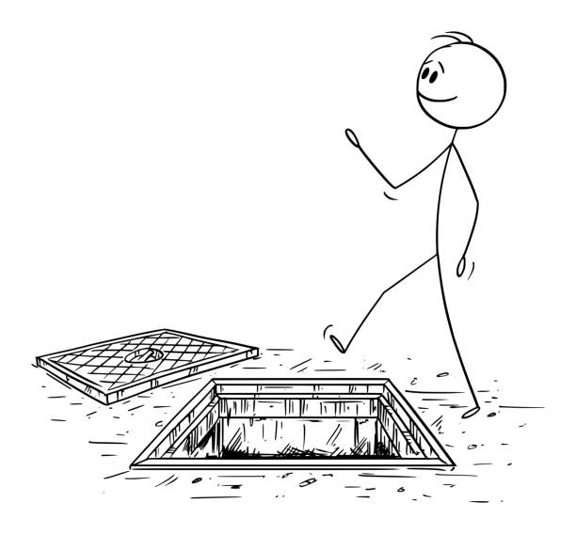
Risks involved in pursuing solutions
Financial risk: Solutions such as establishing a second manufacturing plant, outsourcing manufacturing or making software cloud-base solutions require a high initial investment.
Operational and transition risk: Changing manufacturing processes can disrupt existing supply chain workflows, systems, and processes.
Strategic and execution risk: There is a risk that the selected solution will not deliver the expected benefits if market conditions change or operating costs do not decrease.

Slide 19
Relevant Legislative and Organisational Requirements, Policies and Procedures

Slide 20

Relevant Legislation
Financial and Consumer Law
Corporations Act 2001.
Anti-Money Laundering and Counter-Terrorism Financing Act 2006 (AML/CTF
Secured Transactions Act 2009
Competition and Consumer Protection Act 2010
Privacy and Data Security
The Privacy Act 1988
Australian Privacy Principles (PPA

Slide 21


Relevant Legislation
Employment and Performance Management
The Fair Work Act 2009
Digital Security and Cybersecurity
Cybercrime Act 2001

Slide 22


Relevant Legislation
Technical Barriers to Trade (TBT)
The Copyright Act of 1968

Slide 23
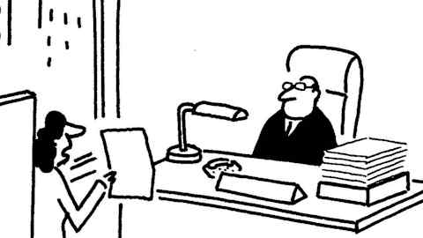
Summary of Policies and Procedures
Finance Authorisation Policy and Procedures
Establishes a mandatory governance framework for all transactions
Procedure:
Approval Authority Credit Card Issuance
Usage Limits
Reconciliation

Slide 24

Summary of Policies and Procedures
Privacy Policy and Procedures
Protecting personal information Based od Australian Privacy Principles (APPs) and the Privacy Act 1988
Procedure:
Data Collection
Physical/Digital Storage
Cyber Prevention

Slide 25

Summary of Policies and Procedures
Performance Management Policy and Procedures
Focuses on procedural fairness, transparency, and professional development.
Procedure:
Review Cycle
Evaluation
Dispute Resolution
Rewards

Slide 26

Summary of Policies and Procedures
Documentation policy and Procedures
Deseing to ensure consistency, version control, and efficient retrieval across the organization.
Procedure:
Standardization
.
Naming Convention
Storage
.
Feedback Loop

Slide 27
Assessment of bias
Perceived
Financial Performance Bias
Excessive focus on revenue growth as an indicator of success, ignoring the impact of rising operating costs.

Slide 28
Assessment of bias
Actual
Operational and Manufacturing Bias
Reliance on a single plant in Hong Kong based on past successes

Slide 29
Assessment of bias
Perceived
Technology and ERP Bias
The current ERP system were sufficient to manage global disruptions.

Slide 30
Thank you
By Manuel Perez

